Slide 1
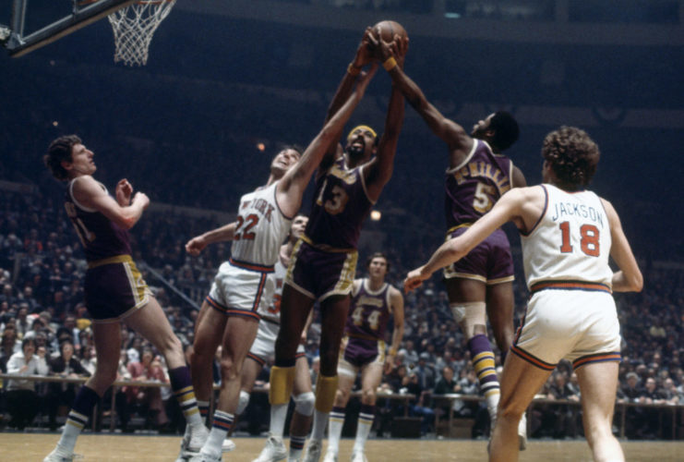

NBA Wins-Made Predictions From College Stats
Adam McCaw, Alan Dimitriev, Hayden Wang, Noah Rowe

Slide 2

Problem Description
Hypothesis: College stats and success are a good predictor of how impactful a player will be if he reaches the NBA
Given the average of several years of college basketball stats and physical metrics (ie. height) for each player, predict the wins-made achieved in the NBA
wins-made = NBA metric of how many wins as a team are a result of that player’s contribution in-game

Slide 3
Data Description
Data was collected from various statistics websites
BasketballReference.com, NBA.com, BasketballGM.com, …
Ranges from 2001-2002 to 2017-2018 seasons
Ignores draft-eligible players that did not play in NBA and international recruits
Contains college statistics, biometric data, player rankings, and mock draft results

Slide 4
Data Preparation
Missing values were addressed using mean imputation
Predictive imputation was entertained but not implemented
Feature columns were scaled using Standard Scaling
Looks to remove data mean and scale to unit variance
Highly correlated feature columns were removed
Height with shoes (correlated with height)
Reach (correlated with wingspan)

Slide 5
Regressive Multi-Layer Perceptron Neural Network
Adam McCaw

Slide 6
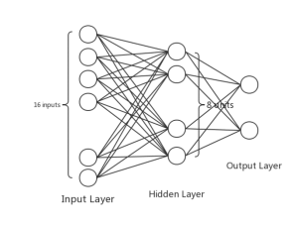
Related Work
BPNN that uses NBA season stats to predict NBA regular season MVP (2019)
3-layer BPNN
Probability output of how likely the player is to be MVP (regressive)
Available at: doi: 10.1145/3357777.3357786
Y. Chen, J. Dai, and C. Zhang, “A Neural Network Model of the NBA Most Valued Player Selection Prediction,” in Proceedings of the 2019 the International Conference on Pattern Recognition and Artificial Intelligence - PRAI ’19, Wenzhou, China, 2019, pp. 16–20, doi: 10.1145/3357777.3357786.

Slide 7

Model
Dropout (0.1)
4-layer MLP (1 input, 2 hidden, 1 output)
Linear 1 node output (regressive)
Loss = Mean Squared Error
Optimizing Algorithm = Adam
Training = 85% of 663
Validation = 15% of Training
Testing = 15 % of 663
100 Epochs, Batch Size = 0
21, Sigmoid
7, Relu
53, Input
1, Linear

Slide 8
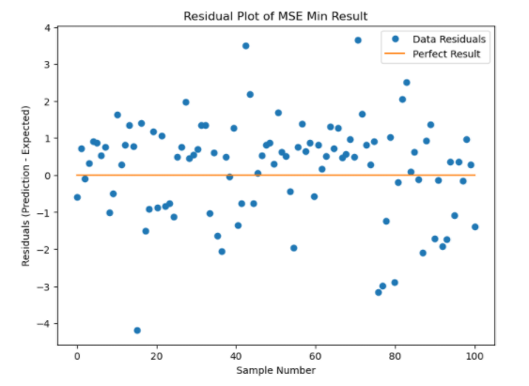
Results
Averaged 50 model results with different training and testing data
Average MSE = 2.26
Min MSE = 1.13
Average Training MSE = 2.10
Performs better when WM is low
Most Results are 0-1.5 off expected

Slide 9
Radial Basis Function Network
Hayden Wang

Slide 10
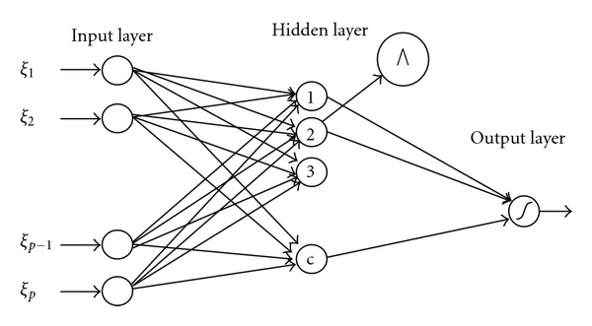
Related Work
Predicting Performance and Emission of Diesel Engine that uses Waste Cooking Oil
Uses RBF
https://www.hindawi.com/journals/aai/2012/610487/

Slide 11
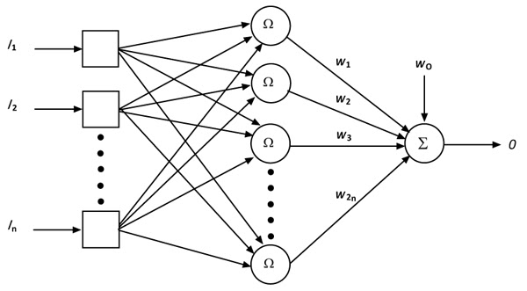
Approach
3-layer feedforward network
1 Hidden layer with RBF Nodes
Gaussian Activation Function for each RBF Node
1 RBF Node for each training sample (530)
Uniform initial distribution of weights

Slide 12
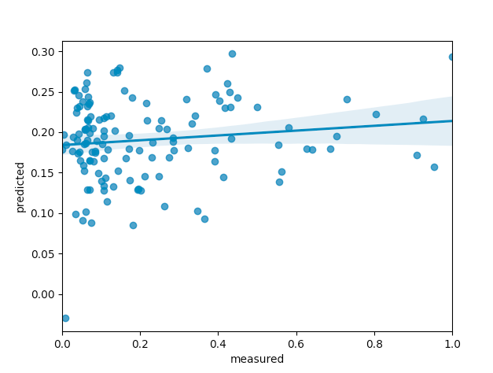
Results
Predicts that most players will have a normalized wins-made of around 0.2
Performs well when actual wins made (normalized) is lower
MSE = 1.67

Slide 13
Segregated Multilayer Neural Network with Dropout
Noah Rowe

Slide 14
Related Work
"The Automated General Manager", Maymen, Journal of Global Sports Management
Outlines a similar approach to assess draft picks using a Random Forest model
"Predicting In-Game Actions from Interviews of NBA Players", Oved Et. Al., Computational Linguistics
A study utilizing text-analysis of player interviews to predict player performance

Slide 15
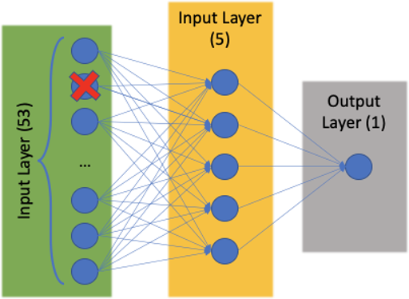
Multilayer Dropout Neural Network
Three layers of feedforward neurons
Dropout layer implemented following data input
Single output node using linear activation
Training parameters:
Optimizer: Adam
Loss: Mean Squared Error
Epochs: 20
Batch Size: 20
Dropout rate: 0.1
Hidden Layer (5)

Slide 16
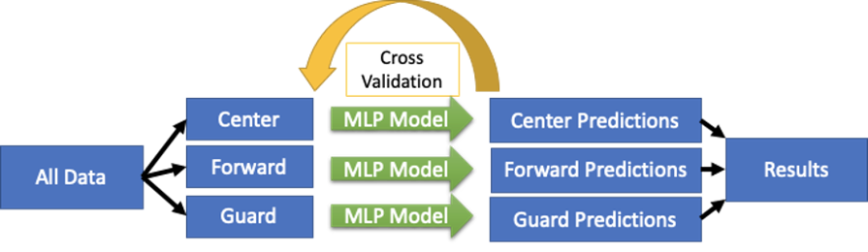
Model Segregation

Slide 17
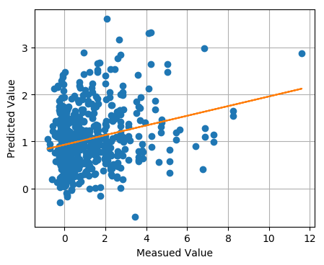
Results
Results were assessed using Mean Squared Error
Center Model: 2.00 WM
Forward Model: 2.00 WM
Guard Model: 3.09 WM
Overall Model Error: 2.23 WM
Each model is unable to predict higher values in the dataset

Slide 18
SELU Deep Neural Network With Binned Classifications
Alan Dimitriev

Slide 19
Related Work
Analysis of basketball games using neural networks
Z. Ivanković, M. Racković, B. Markoski, D. Radosav and M. Ivković, "Analysis of basketball games using neural networks," 2010 11th International Symposium on Computational Intelligence and Informatics (CINTI), Budapest, 2010, pp. 251-256, doi: 10.1109/CINTI.2010.5672237.
Uses a multi-layered perceptron to utilize ingame statistic to predict wins.

Slide 20
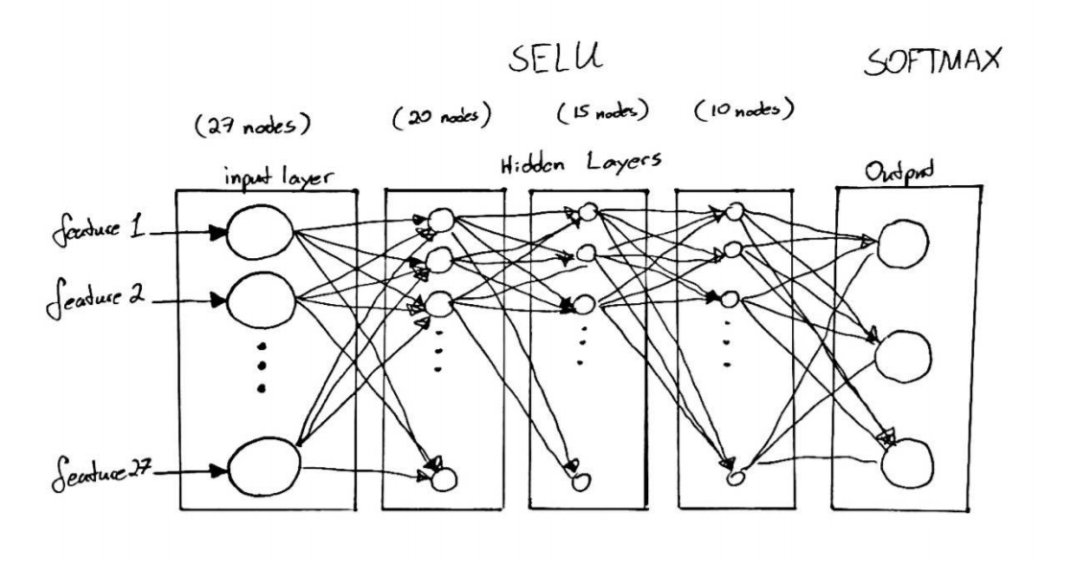
Approach
Five layer feedforward MLP that outputs via three softmax nodes
Three hidden layers using SELU activation functions
Two dropout layers used on hidden layers to increase weight diversity
Run 20 models to account for dropout and weight variance, take the one with highest accuracy
Training parameters:
Optimizer: Ftrl
Loss: Categorical Cross Entropy
Epochs: 50
Dropout rate: 0.2

Slide 21
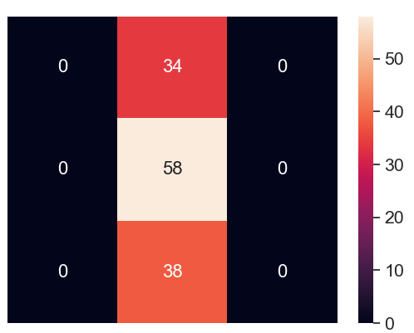
Results
Due to distribution of WM values in dataset, model was unable to correclty classify the data. Aim was to predict whether a player had a "Good", "Bad", or "Neutral" WM in regard to how they would affect their future team.
Due to lack of data at higher end of WM (only 9% of players had WM of above 3) the model can't accuractly predict whether a player falls into specific categories.
Data set did not lend well to classification
Good
Neutral
Bad
Pred Good
Pred Bad
Pred Neutral

Slide 22
Open Problems and Conclusion
Data set lacked enough players with high WM values, this made it hard for our models to predict high WM.
This makes it difficult to accuractly classify binned target values as the network skews towards the data it has available.
Overall data correlation seems low due to mediocre results for all group members
The aim was to use data that we collected ourselves to produce a project that we would have personal interest in, however this did not work as well as we intended
Architectures were deemed suitable for the task, with the data causing poor results

